Slide 1


Movie Review Prediction Using Twitter Data
Group Number: Instructor: Dr. Ziad Kobti
Group Members:
Harshitha Inti
Prakash Kothapalli
Sai Sireesha Tirumala Pudi

Slide 2

PROBLEM STATEMENT
Generally before watching a movie, people look for the reviews either in websites like IMDB or ask for public talk. This information is not enough for the audience to analyze regarding movies using naïve methods. The main platform where people often share their thoughts about movies is “TWITTER”.
Twitter a micro blogging network now plays a vital role in the research of social network. People share their likings or dislikes on Twitter using limited length texts (called tweets) which provide rich information for film industries who want to know about whether people like certain movie or not. However, the most effective method to detect and outline user preference accurately remains a challenging issue..!!

Slide 3
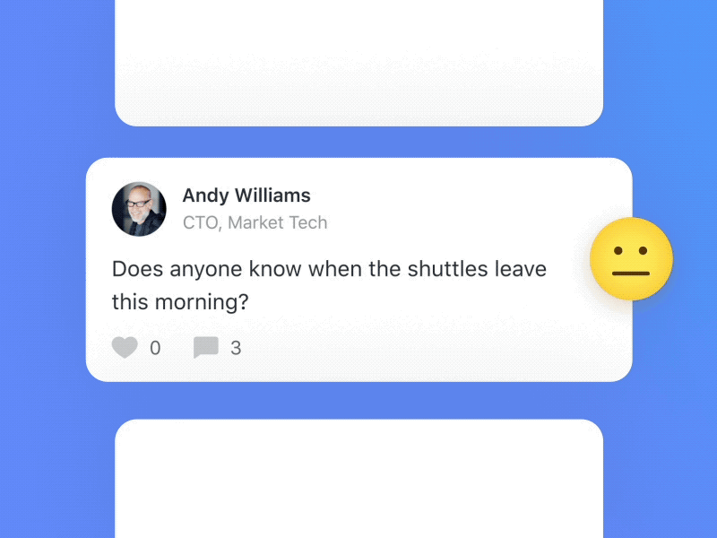
MOTIVATION
We have decided to work with twitter since we feel it is a better approximation of public sentiment instead of web articles or web blogs. The reason is that the measure of relevant information is a lot bigger for twitter, as compared to traditional blogging sites. Moreover the response on twitter is more prompt and more general since the number of users who tweet is significantly more than the individuals who write web blogs regularly.
One of the Text Analytics solutions that emphasize the data in more detailed level is by comparing various opinions using “Sentiment Analysis”.
This could be possible by analyzing overall public sentiment towards the film by finding the correlation between public sentiment. Industries can also evaluate how well their movie is responding in the market, which areas or regions is it having a favorable reaction and in which regions have a negative reaction since twitter enables us to download stream of geo-labeled tweets for specific areas.
If film industries can get this data, they can analyze the reasons, behind geo-graphically differentiated response, thus they can market their film in a more optimized way by looking for appropriate solutions.

Slide 4
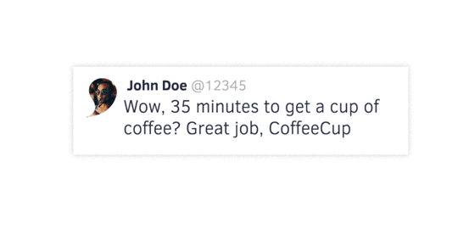
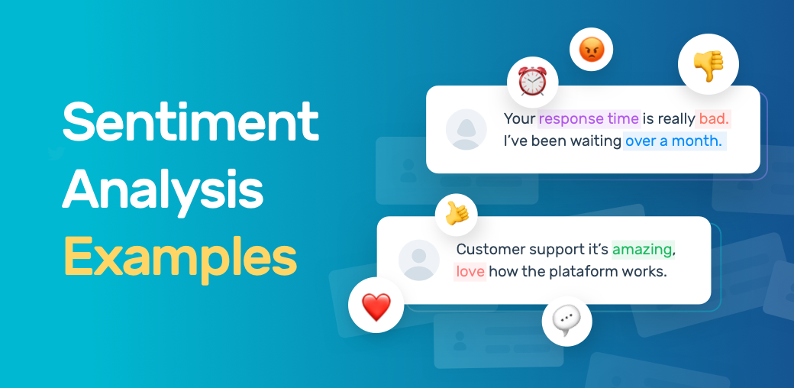
PROCEDURE
When a user wants to know the review of the movie based on the tweets, user enters a movie name and starts searching.
The searched term is then stored in a variable and passed the variable to python script.
Tweets are extracted using tweepy are then divided into positive, negative and neutral tweets and the tweets are processed to sentiment analysis.
Based on each tweet polarity, the tweets are divided, and information is parsed to the google API’s to display maps and graphical charts.
For portraying number of tweets from each region on the map, we used Google geo charts API
Percentage of categorized tweets are displayed in a pie chart using google API
Positive, negative and neutral tweets obtained are further displayed in drop downs.

Slide 5
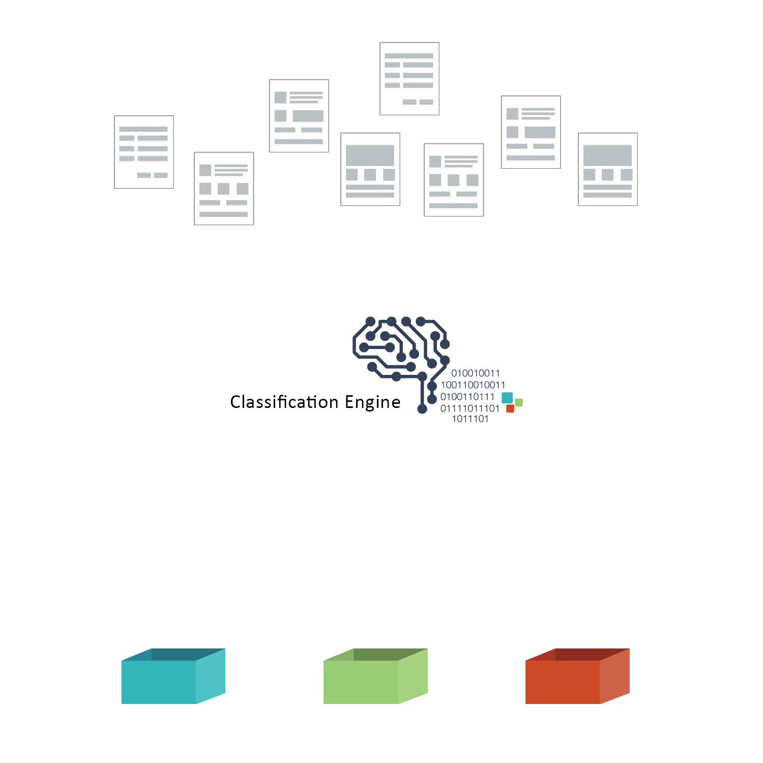

TECHNOLOGIES USED
For developing front end of the webpages, we used Html, CSS, Bootstrap and Java Script.
Google APIs are used to display charts and maps.
Python is used to write the backend of website.
Atom editor is used for writing and making changes in the weblinks created.
For connectivity, we used Django python-based framework for connecting frontend, backend, styling, images, videos and Java Scripts.

Slide 6
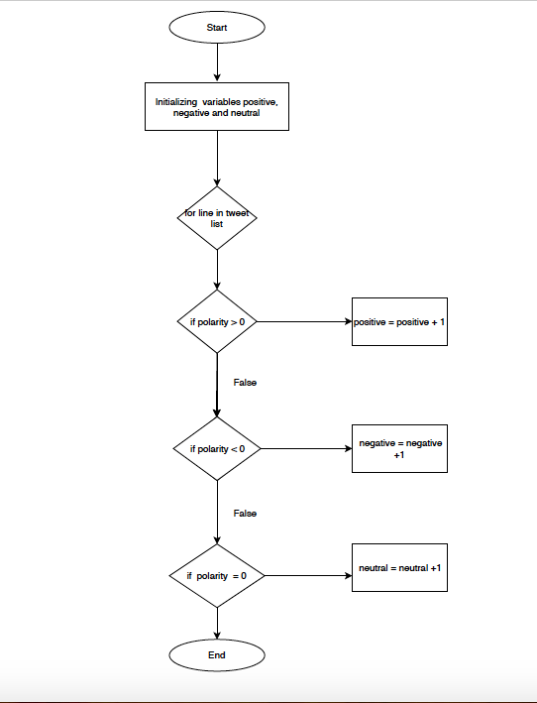
ALGORITHM

Slide 7
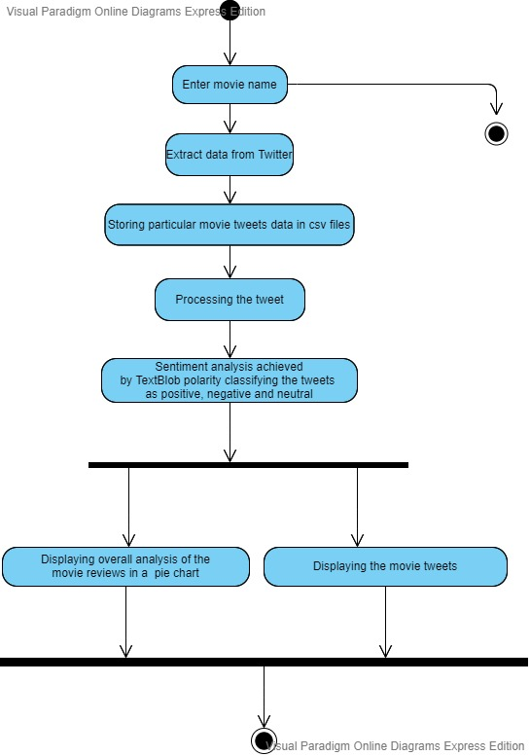
UML - ACTIVITY Diagram

Slide 8
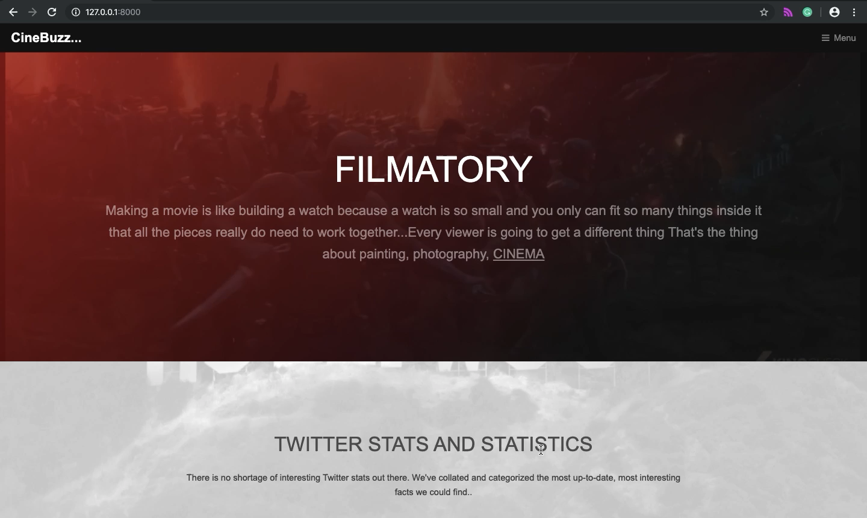

Slide 9
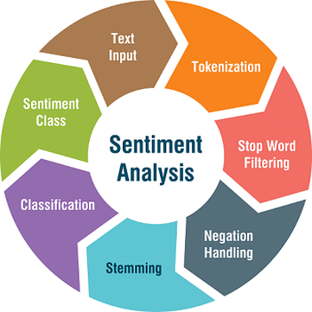
CONCLUSION
Our website gives the genuine overall review of the movie based on the latest tweets along with individual rating of positive, negative and neutral tweets. User can make his decision to watch a movie easily instead of using naive techniques. Sentiment Analysis is efficient to implement Twitter data sentiment analysis. Usually it is difficult to predict the sentiment for every single movie tweet as it has repeated words, words using slang, hash tags, misspelled words etc., which is a unstructured data. Using TextBlob Python library, the sentiment analysis easily analyzes the emotion of each tweet and classifies the positive, neutral and negative tweets.

Slide 10

FUTURE WORK
On our future work we are planning to enhance more efficient feature on our website.
Our future work includes:
Providing the list of movies in a specific region along with the theatre details and location of the theatre where the movie is playing.
A chat bot feature called "Tweet bot" to make more user friendly.
Enlarging the targets of sentiment - To analyze the sentiments of all current trending topics in every location along with the movies.

Slide 11

“If in the end you don’t like the movie, that’s fine it happens. But there’s always the chance that you might end up really enjoying a film that the critics didn’t like”.
THANK YOU!

